Slide 1

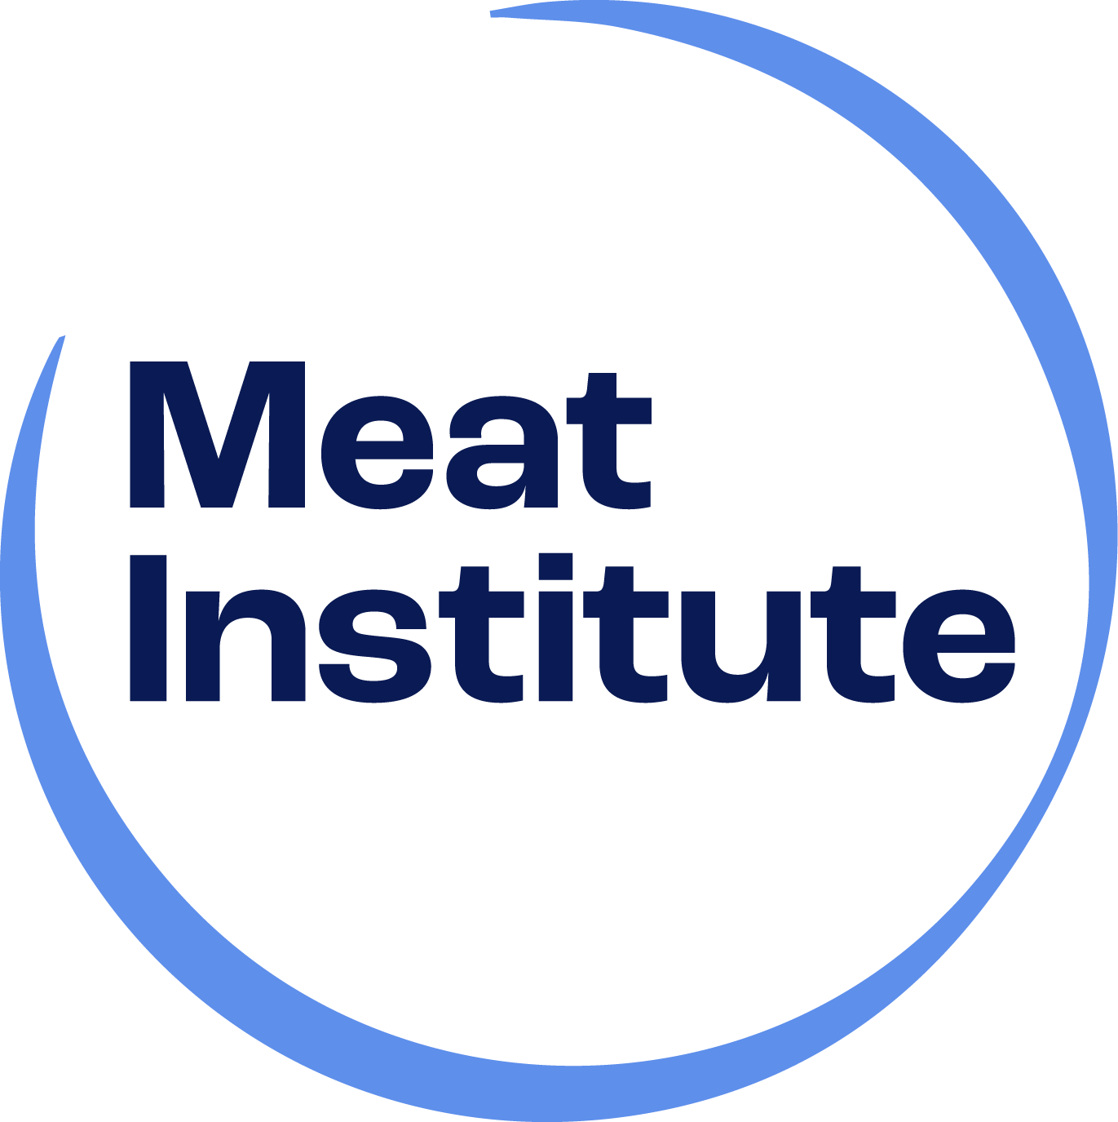
Meat Institute
Reporting
A member-led commitment to best practices and industry progress.
Notes:
What is Meat Institute Reporting? It's a voluntary industry benchmarking exercise administered by the Meat Institute that showcases commitment to best practices and industry progress.

Slide 2

What is Meat Institute Reporting?
What Does Reporting Cover?
Meat Institute Reporting is a member-led, member-driven process that gives
packer-processors a platform to track achievements and gain valuable business insights.
By participating, packer-processors help demonstrate the meat industry’s collective commitment to animals, humans and the planet—meeting the expectations of today’s customers and consumers.
Food Safety
Labor & Worker Safety
Animal Welfare
Environment
Health & Wellness
Notes:
Meat Institute Reporting is a member-led,member-driven process that gives packer-processors a platform to track achievements and gain valuable business insights into their operational activities, policies, or protocols in relation to the industry aggregate information. Information is self-reported by USDA establishment identification number or the equivalent (for Mexico or Canadian establishments) on the topics of food safety, people, animal welfare, environment, and more. A company can pick and choose which focus areas to report on.

Slide 3
Why Participate?
Gain Business Insights – Identify trends, measure progress and drive
continuous improvements.
Strengthen Your Practices – Benchmark performance against the industry and adopt best practices.
Showcase Industry Leadership – Demonstrate your commitment and progress to ethical and sustainable practices in food safety, animal welfare and labor.
Learn from Industry Peers – Gain insights from industry leaders shaping metrics, education and innovation. The reporting portal is a knowledge hub, advancing the Meat Institute’s education plan and committee efforts to drive industry growth.
Shape the Future of the Industry – Contribute to industry-wide progress and help set benchmarks for responsible protein production.

Slide 4
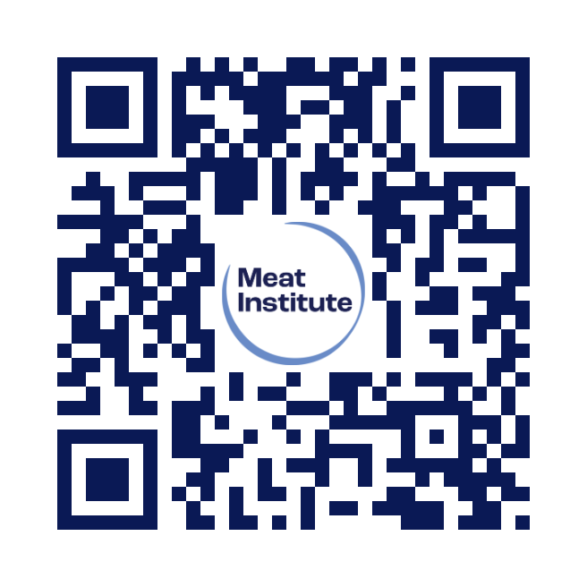
How Does It work?
Take the Next Step
1.
Sign Up & Access Reporting
Select Applicable Metrics
Use Available Resources
Submit Your Data
Gain Insights & Benchmark Performance
Contribute to Industry-Wide Progress
2.
3.
4.
5.
6.
For more information, visit:
www.meatinstitute.org/reporting
or contact Kristi Block at kblock@meatinstitute.org

